Slide 2
Need Money to Help Pay for College? You are not alone.
Filling out the FAFSA form is the first step to getting financial aid. It is the application required by all schools in awarding federal student aid to those who qualify. The FAFSA form helps you get access to get:
Federal Grants
Federal student loans
Federal work study
State loans
State grants and scholarships
Grants and scholarships from other organizations.

Slide 3
What is FAFSA?
Free Application for Federal Student Aid
The FAFSA is the application students fill out in order to determine their financial aid eligibility. FAFSA needs to be filled out each academic year. You can submit a FAFSA at www.fafsa.gov.
Notes:
Every student who meets certain eligibility requirements can get some type of federal student aid, regardless of age or family income.

Slide 4
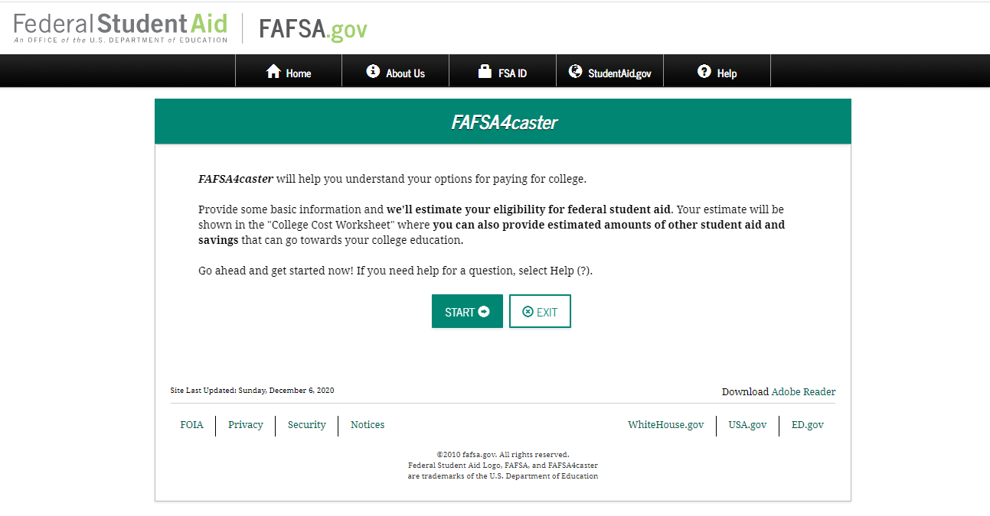
https://fafsa.ed.gov/spa/fafsa4c/#/landing
Notes:
The FAFSA4caster will help you understand your options for paying for college. You'll provide some basic information and the federal student aid/FASFA will estimate your eligibility for federal student aid.

Slide 5
What is a Pell Grant?
Federal Pell
Grant
(does not have to be repaid)
FOR undergraduates with exceptional financial need who have not earned bachelor’s or professional degrees.
AMOUNTS can change yearly. The maximum Federal Pell Grant award is $6,195 for the 2019–20 award year (July 1, 2019, to June 30, 2020).
Visit StudentAid.gov/pell-grant for more information.
Notes:
A Pell grant are for undergraduates with exceptional financial need and does not have to be paid back.

Slide 6
What is work study?
For undergraduate and graduate students; part-time jobs can be on campus or off campus. Money is earned while attending school.
Does not have to be repaid.

Slide 7
What is a Student loan?
Student loans, unlike grants and work-study, are borrowed money that must be repaid, with interest, just like car loans and home mortgages. You cannot have these loans canceled because you didn’t like the education you received, didn’t get a job in your field of study, or are having financial difficulty. So think about the amount you’ll have to repay before you take out a loan.

Slide 8
Student Loan Repayment Example

Slide 9
A good approach to financial aid is:
First, accept free money (scholarships and grants), i.e., funds you don’t have to pay back;
Then, accept earned money (work-study), i.e., funds you earn through a job; and
Finally, accept borrowed money (student loans), i.e., money you have to pay back with interest.

